Slide 2
Financial Data

Slide 3

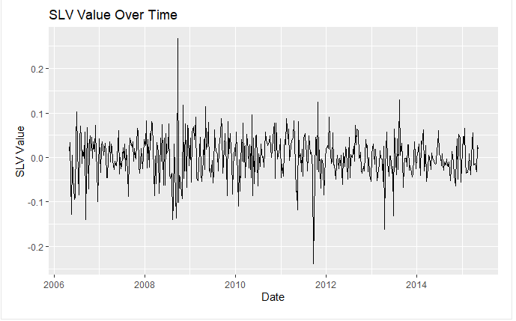
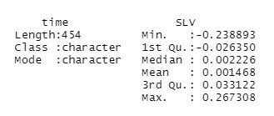
Descriptive statistics
EFT: Weekly returns from Exchange Traded Fund
2 columns : date and weekly returns (the ratio between the final and initial price for that week minus 1) of 1 ETF

Slide 4
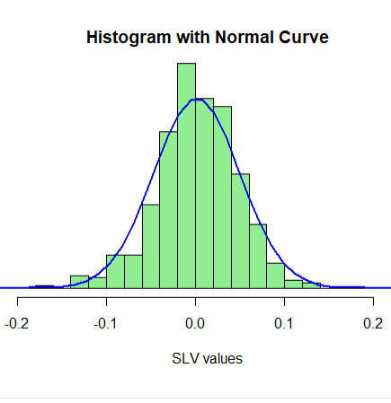
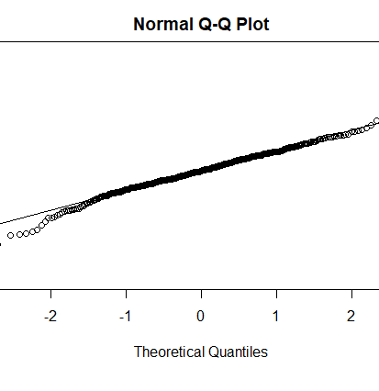
Is the data normal ?

Slide 5

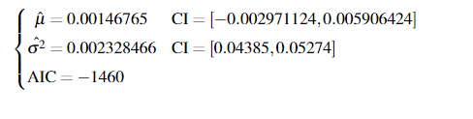
Fitting normal model

Slide 6
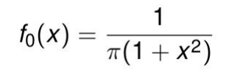
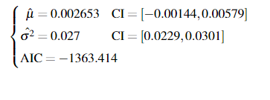
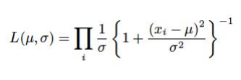
Hypothesis 1: Cauchy model
Cauchy distribution accounts for heavy tails

Slide 7
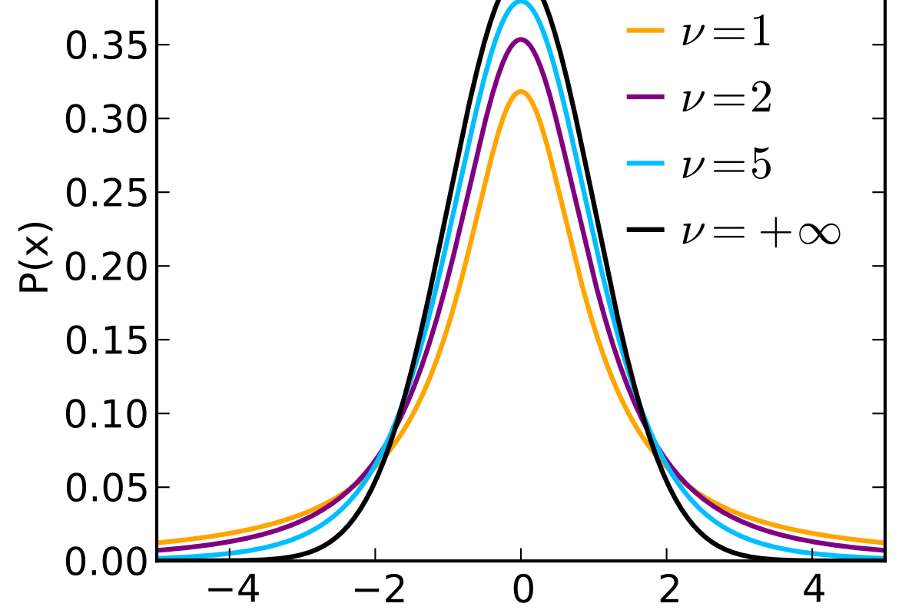
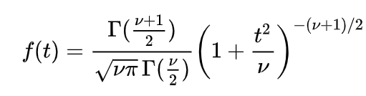
Hypothesis 2 : Student t-distribution
Test with a few degree of freedom
AIC: -1492 (df = 8)

Slide 8
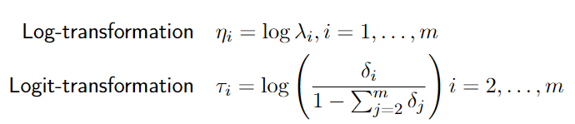
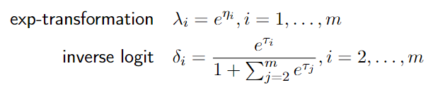
Mixture Models
Fit with 2 or 3 normal models
Transform parameters to get an unconstrained optimization problem
To come back to our natural parameters :

Slide 9


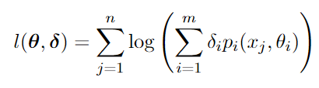

Models
2 components:
3 components:
Likelihood for m components :

Slide 10
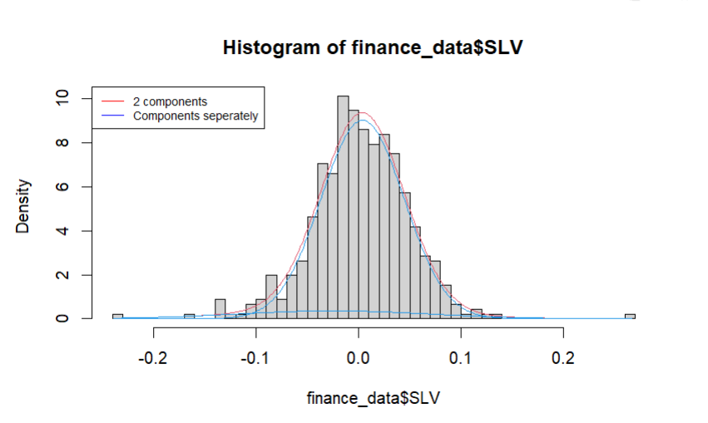
2 components model summary
 | Component 1 | Component 2
μ | 0.004 | -0.03
σ^2 | 0.04 | 0.1
δ | 0.91 | 0.09
AIC: -1489
Confidence Interval | Model 1 | Model 2
Lower Bound | -0.0008 | -0.07
Upper Bound | 0.009 | 0.02

Slide 11
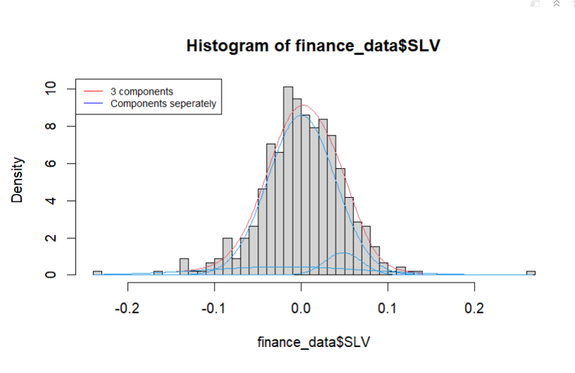
3 components model summary
 | Comp1 | Comp2 | Comp3
μ | 0.00 | 0.05 | -0.02
σ | 0.04 | 0.02 | 0.09
δ | 0.83 | 0.06 | 0.10
AIC: -1484

Slide 12
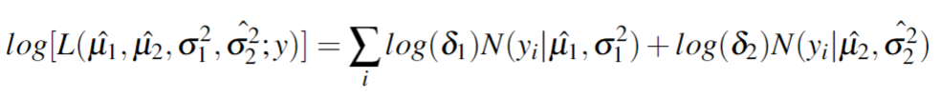
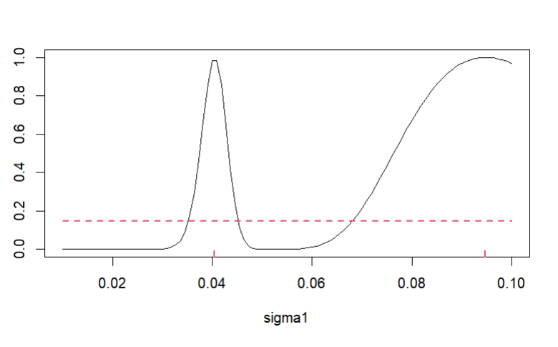
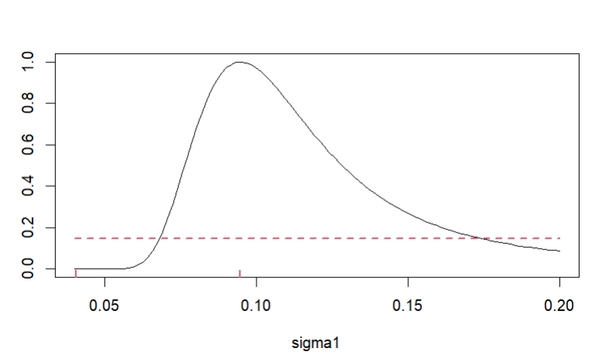
Profile Likelihood of Sigma 1 and reparametrization

Slide 13
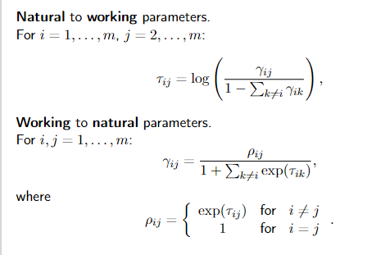
Hidden Markov Model
Fit with 2 or 3 states
Transform parameters for an unconstrained optimization problem
Compare the results using AIC and BIC

Slide 14
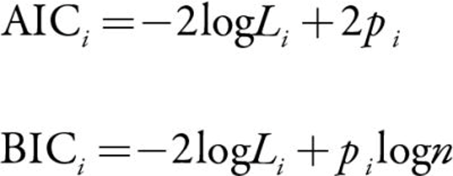
2 states versus 3 states model comparision
 | 2 States | 3 States
AIC | -1499 | -1471
BIC | -1507 | -1450
Conclusion:
The 2 States model is better either with fitting the data (BIC) or with predicting new values (AIC)

Slide 15
2 States Model Summary
State Transition Parameters
 | MLE estimator | Lower bound | Upper bound
1 to 1 | 0.97 | 0.93 | 1
1 to 2 | 0.03 | 0.00 | 0.07
2 to 1 | 0.21 | 0.01 | 0.41
2 to 2 | 0.79 | 0.59 | 0.99
Normal Model Parameters
 | MLE estimator | Lower bound | Upper bound
Mean State 1 | 0.005 | 0.001 | 0.009
Std State 1 | 0.039 | 0.035 | 0.043
Mean State 2 | -0.024 | -0.055 | 0.008
Std State 2 | 0.083 | 0.062 | 0.103

